Slide 1
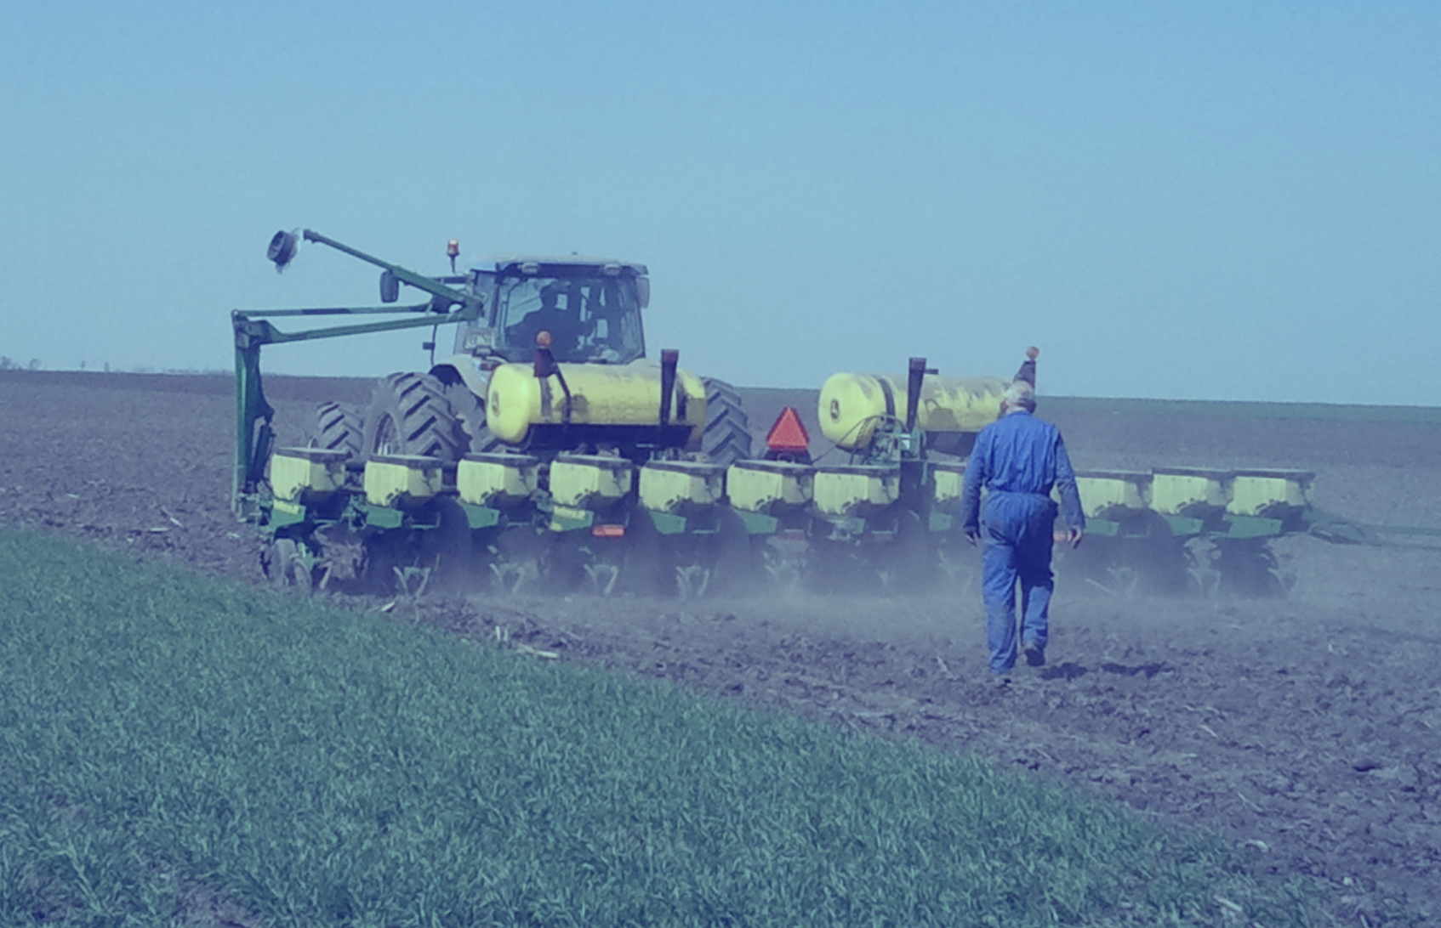
VeXtronics
Name: Erik Vermeer
Project: Robotic Planting Solutions
Contact: erik@vextronics.nl
Agricultural & Outdoor Robotics

Slide 2

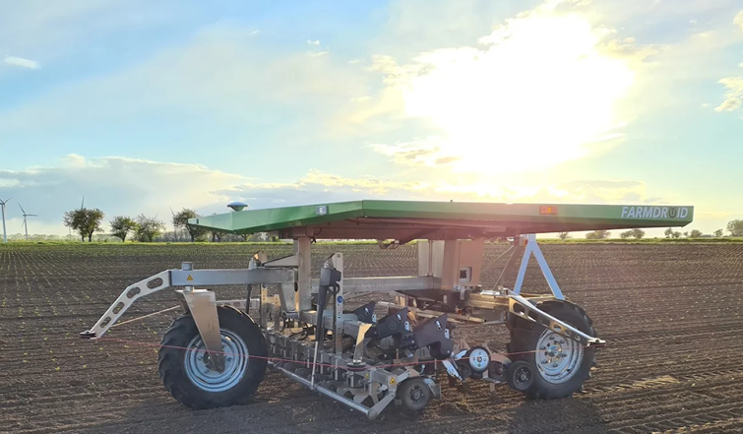
What is Autonomous Farming?
Concept:
Using autonomous robots to perform farming actions
Opens up new possibilities:
More precision
No more human errors
Allows for higher speeds
Your challenge: Use robotics & AI to optimize planting of corn seeds.

Slide 3
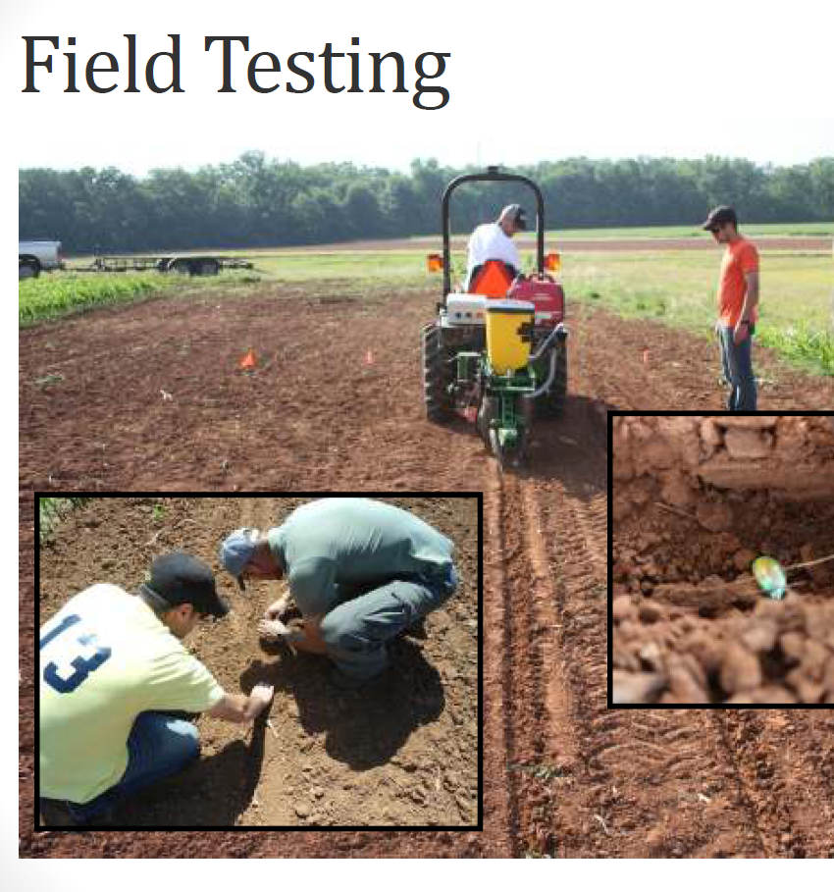
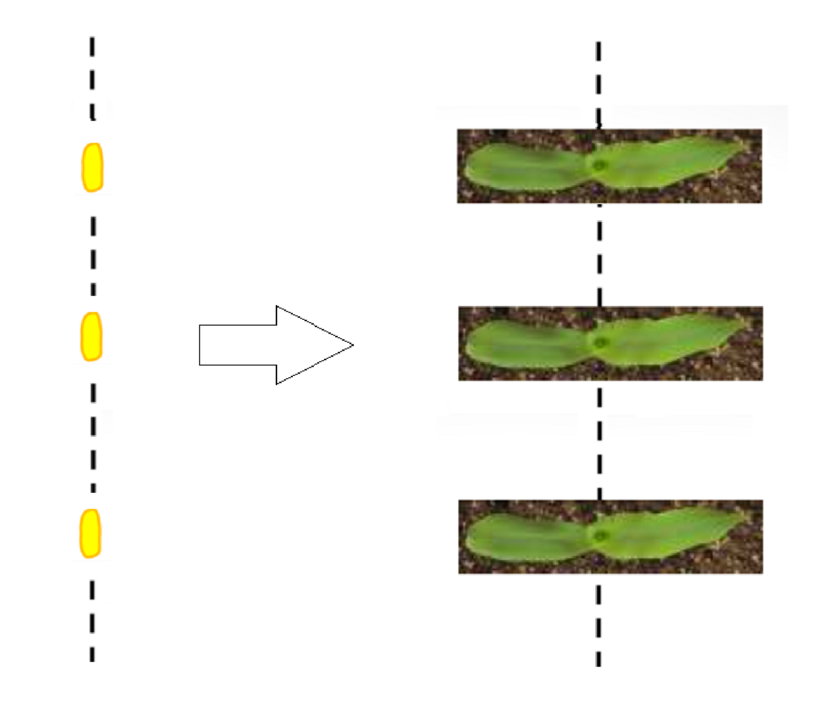
Theory: Planting corn in A predefined alignment

Slide 4
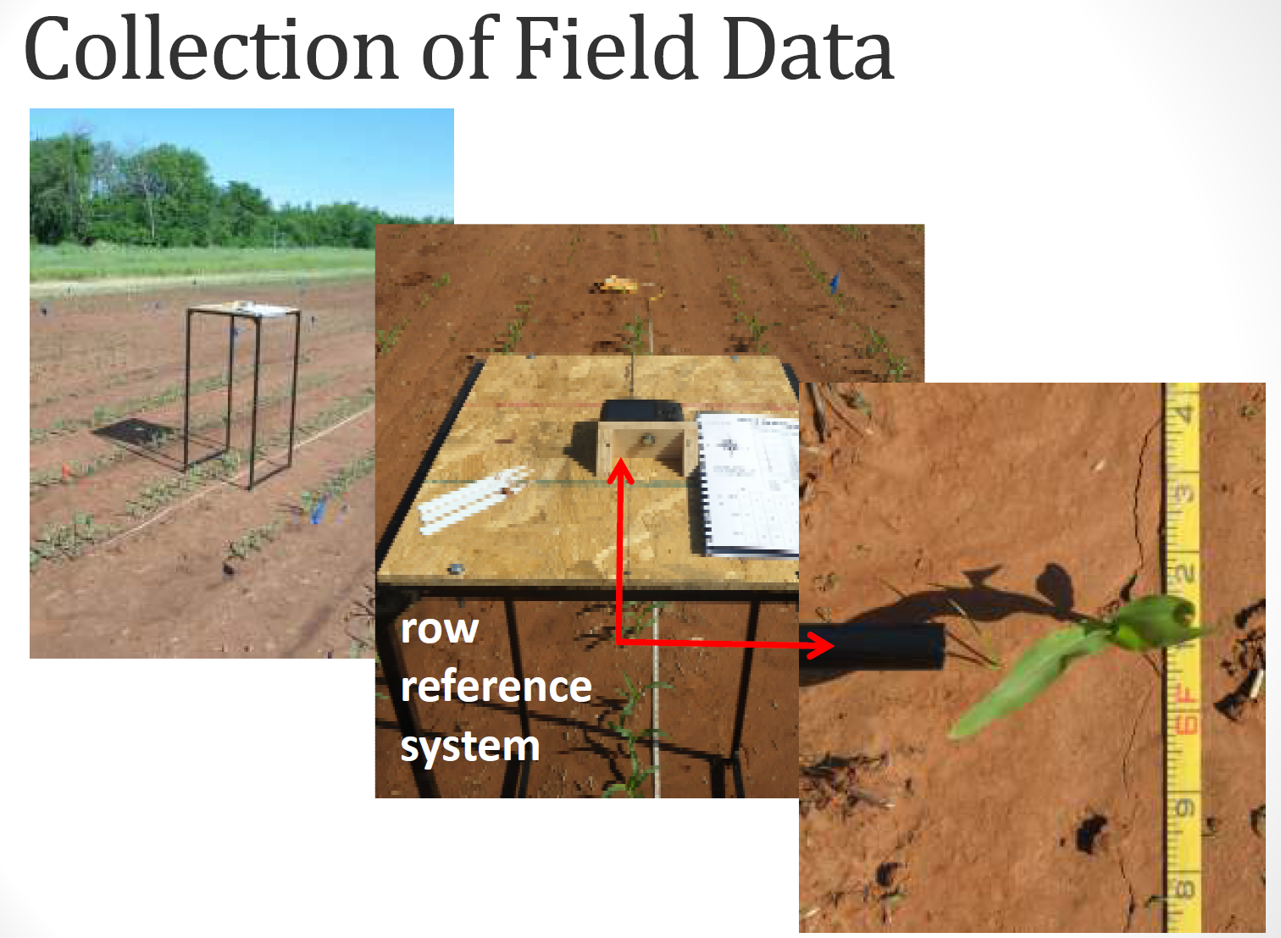
Problem: How to determine the average leave orientation?
Your mission:
Create good quality plant data of corn seedlings.
Feed into AI object detection models.
Determination of individual leave orientations.
Show statistical results over the field.

Slide 5
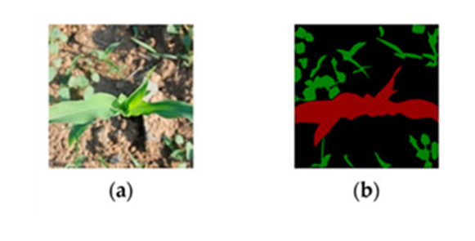
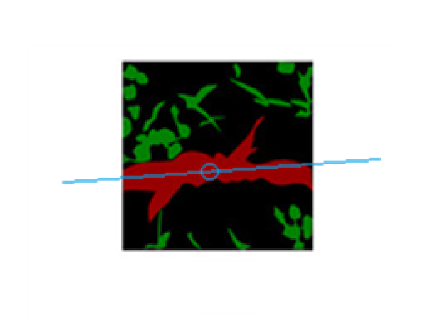
Determination of leave orientations using AI techniques
Can we recognize the corn leave shapes using Semantic Segmentation?
How to calculate leave orientation and plant center from the leave shape?

